Slide 1

Chapter 15 Templates

Slide 2
Objectives
To know the motivation and benefits of templates (§15.2).
To declare template function with type parameters (§15.2).
To develop a generic sort function using templates (§15.3).
To develop generic classes using class templates (§§15.4-15.5).

Slide 3
Templates Basics
Let us begin with a simple example to demonstrate the need for templates. Suppose you want to find the maximum of two integers, two doubles, and two characters, you might write three overloaded functions as follows:

Slide 4
Templates Basics
int maxValue(const int &value1, const int &value2)
{
if (value1 > value2)
return value1;
else
return value2;
}

Slide 5
Templates Basics
double maxValue(const double &value1, const double &value2)
{
if (value1 > value2)
return value1;
else
return value2;
}

Slide 6
Templates Basics
char maxValue(const char &value1, const char &value2)
{
if (value1 > value2)
return value1;
else
return value2;
}

Slide 7
Generic Function
GenericType maxValue(
const GenericType &value1, const GenericType &value2)
{
if (value1 > value2)
return value1;
else
return value2;
}

Slide 8
Generic Functions
C++ enables you to define a function template with generic types. Listing 15.1 defines a template function for finding a maximum value between two values of a generic type.
GenericMaxValue
Run

Slide 9
match parameter
The generic maxValue function can be used to return a maximum of two values of any type, provided that
The two values have the same type;
The two values can be compared using the > operator.

Slide 10
<typename T> preferred
You can use either <typename T> or <class T> to specify a type parameter. Using <typename T> is better because <typename T> is descriptive. <class T> could be confused with class declaration.

Slide 11
multiple type parameters
Occasionally, a template function may have more than one parameter. In this case, place the parameters together inside the brackets, separated by commas, such as <typename T1, typename T2, typename T3>.

Slide 12
Example: A Generic Sort
Occasionally, a template function may have more than one parameter. In this case, place the parameters together inside the brackets, separated by commas, such as <typename T1, typename T2, typename T3>.
GenericSort
Run

Slide 13
developing generic function
When you define a generic function, it is better to start with non-generic function, debug and test it, and then convert it to a generic function.

Slide 14
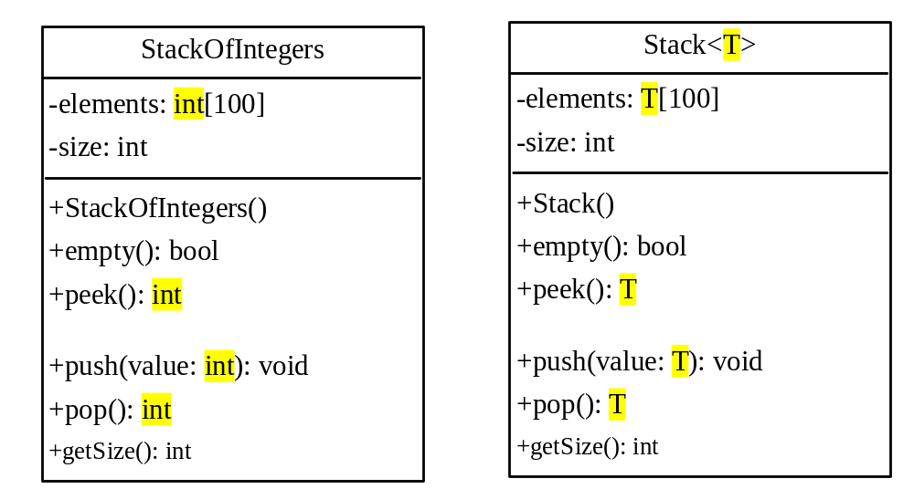
Class Templates
GenericStack
TestGenericStack
Run

Slide 15
compile issue
GenericStack.h combines class declaration and class implementation into one file. Normally, you put class declaration and class implementation into two separate files. However, it is safer to put them together for class templates, because some compliers cannot compile them separately.

Slide 16
default type
C++ allows you to assign a default type for a type parameter in a class template. For example, you may assign int as a default type in the generic Stack class as follows:
template<typename T = int>
class Stack
{
...
};

Slide 17
default type
You can now declare an object using the default type like this:
Stack<> stack; // stack is a stack for int values
You can only use default type in class templates, not in function templates.

Slide 18
nontype parameter
You can also use nontype parameters along with type parameters in a template prefix. For example, you may declare the array capacity as a parameter for the Stack class as follows:
template<typename T, int capacity>
class Stack
{
...
private:
T elements[capacity];
int size;
};

Slide 19
templates and inheritance
A nontemplate class can be derived from a class template specialization. A class template can be derived from a nontemplate class. A class template can be derived from a class template.

Slide 20
template class friends
Friends are used exactly the same for template and nontemplate classes.

Slide 21
static members
You can define static members in a template class. Each template specialization has its own copy of a static data field.

Slide 22
Improving the Stack Class
There is a problem in the Stack class. The elements of the stack are stored in an array with a fixed size 100 (see line 16 in Listing 15.3). So, you cannot store more than 100 elements in a stack. You may change 100 to a larger number. But this would waste space if the actual stack is small. One way to resolve this dilemma is to allocate more memory when needed.
ImprovedStack

